Slide 1


Jan Danel
10/15/2022

Slide 2

Outline
Executive Summary
Introduction
Methodology
Results
Conclusion

Slide 3
Executive Summary
Summary of methodologies
Data Collection Using API
Data Collection Using Web Scraping
Data Wrangling
Exploratory Data Analysis with SQL
Exploratory Data Analysis with Data Visualization
Interactive Visual Analytics with Folium
Machine Learning Prediction

Slide 4
Introduction
In this capstone, we will predict if the Falcon 9 first stage will land successfully.
SpaceX advertises Falcon 9 rocket launches on its website, with a cost of 62 million dollars; other providers cost upward of 165 million dollars each, much of the savings is because SpaceX can reuse the first stage.
Therefore, if we can determine if the first stage will land, we can determine the cost of a launch.
We will use machine learning and the public data to predict if SpaceX will reuse the first stage.

Slide 5

Section 1

Slide 6
Methodology
Executive Summary
Data collection methodology:
Get requests from SpaceX API and Wikipedia web scraping.
Perform data wrangling:
Cleaning the data and preprocessing it.
Perform exploratory data analysis (EDA) using visualization and SQL.
Perform interactive visual analytics using Folium and Plotly Dash.
Perform predictive analysis using classification models:
Found best Hyperparameter for SVM, Classification Trees and Logistic Regression.

Slide 7
Data Collection
SpaceX API
Wikipedia Web Scraping

Slide 8
Data Collection – SpaceX API
How the Data Collection section was conducted.
GitHub URL of SpaceX API: https://github.com/jandanel/IBM-Applied-Data-Science-Capstone/blob/master/Data%20Collection%20API%20Project.ipynb)
Make SpaceX API Request
Decode API Response as JSON
Turn JSON into Pandas Data Frame
Use data frame to gain insight into SpaceX launches using the IDs of each launch
Clean the new data frame

Slide 9
Data Collection - Scraping
How the web scraping process was conducted.
GitHub URL of web scraping: https://github.com/jandanel/IBM-Applied-Data-Science-Capstone/blob/master/Data%20Collection%20with%20Web%20Scraping%20Project.ipynb
Use Get Function to pull information from Falcon9 Launch Wikipedia URL
Created a dictionary with launch records from the HTML tables
Create a BeautifulSoup object from the requested HTML
Extracted all HTML tables

Slide 10
Data Wrangling
How the data wrangling process was conducted.
GitHub URL of data wrangling: https://github.com/jandanel/IBM-Applied-Data-Science-Capstone/blob/master/Data%20Wrangling%20Project.ipynb
Calculate the number of launches on each site
Calculate the number and occurrences of each orbit
Calculate the number and occurrence of mission outcome per orbit type
Create a landing outcome label from the “Outcome” column

Slide 11
EDA with Data Visualization
How the EDA with data visualization process was conducted.
GitHub URL of EDA with data visualization: https://github.com/jandanel/IBM-Applied-Data-Science-Capstone/blob/master/EDA%20with%20Visualization%20Project.ipynb
Scatter Plot
Flight Number vs Payload Mass
Flight Number vs Launch Sites
Bar Chart
Success Rate of Each Orbit
Line Plot
Success Rate by Date (Year)
Payload vs Launch Site
Flight Number vs Orbit Type
Payload vs Orbit Type

Slide 12
EDA with SQL
What SQL queries were performed:
Display the names of the unique launch sites in the space mission.
Display 5 records where launch sites begin with the string 'CCA’.
Display the total payload mass carried by boosters launched by NASA (CRS).
Display average payload mass carried by booster version F9 v1.1.
List the date when the first successful landing outcome in ground pad was acheived.
List the names of the boosters which have success in drone ship and have payload mass greater than 4000 but less than 6000.
List the total number of successful and failure mission outcomes.
List the names of the booster_versions which have carried the maximum payload mass. Use a subquery.
List the failed landing_outcomes in drone ship, their booster versions, and launch site names for in year 2015.
Rank the count of landing outcomes (such as Failure (drone ship) or Success (ground pad)) between the date 2010-06-04 and 2017-03-20, in descending order.
GitHub URL of EDA with SQL: https://github.com/jandanel/IBM-Applied-Data-Science-Capstone/blob/master/EDA%20with%20SQL%20Project.ipynb

Slide 13
Build an Interactive Map with Folium
Folium Markers were used to show the SpaceX launch sites and their nearest important landmarks.
Polylines were used to connect the launch sites to their nearest landmarks:
Red represents rocket launch failures.
Green represents rocket launch successes.
GitHub URL of interactive map with Folium map: https://github.com/jandanel/IBM-Applied-Data-Science-Capstone/blob/master/Interactive%20Visual%20Analytics%20with%20Folium%20Project.ipynb

Slide 14
Build a Dashboard with Plotly Dash
Pie charts and Scatter plots were used to visualize the launch records of SpaceX. These charts displayed the rocket launch success rates per launch site.
We were able to get an understanding of the factors that may have been influencing the success rate at each site. Such as the payload mass and booster version.
Successful launches were represented by 1 while failures were represented by 0.

Slide 15
Predictive Analysis (Classification)
Create a column for the class
Standardize the data
Split data into training and testing data
Create a GridSearchCV object
Fit different ML object using GridSearchCV
Calculate test data accuracy
Compare test data accuracy across different ML methods
Choose best performing ML method
How predictive analysis was conducted.
GitHub URL of predictive analysis: https://github.com/jandanel/IBM-Applied-Data-Science-Capstone/blob/master/Machine%20Learning%20Prediction%20Project.ipynb

Slide 16
Results
The exploratory data analysis has shown that successful landing outcomes are somehow correlated with flight number.
Since the year 2013, there has been a significant increase in successful landings.
All launch sites are located near the coastlines, highways and railways.
Through machine learning we found that Logistic regression and K Nearest Neighbor can predict landing success with an accuracy of 100%.
Note: I encountered issues importing the data into IBM Watson Studio and received various errors throughout the Machine Learning Prediction Project. So, the 100% accuracy of the two methods is probably due to an error.

Slide 17

Section 2

Slide 18
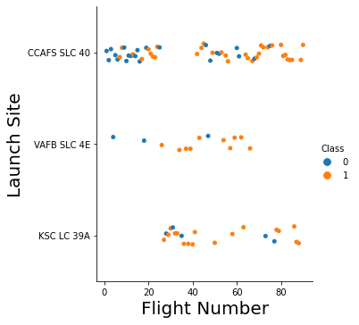
Flight Number vs. Launch Site
It appears the higher the flight number, the more successful the launch (Class 1).
It looks like CCAFS SCL 40 had the most launch failures.
VFAB SLC 4E and KSC LC 39A seem to be more successful.

Slide 19
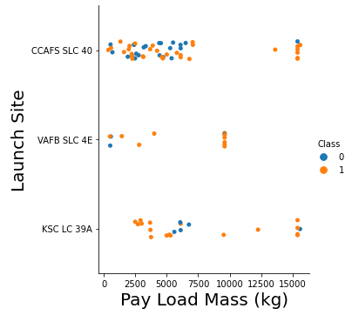
Payload vs. Launch Site
All but 3 launches were successful for payloads larger than or equal to 10,000 kg.
VAFB SLC 4E never had a payload larger than 10,000 kg.

Slide 20
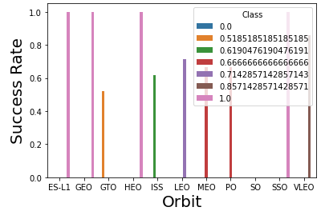
Success Rate vs. Orbit Type
The most successful launches are those who orbit ES-L1, GEO, HEO, SSO, and VLEO with success rates larger than 80%.
Orbits of GTO, ISS, LEO, MEO, PO, and SO had success rates lower than 80%.

Slide 21
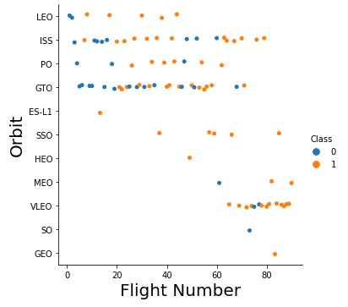
Flight Number vs. Orbit Type
Once again, the higher the flight number, the more likely the launch is a success (Class 1).
Orbits GEO, VLEO, MEO, HEO, SSO, ES-L1, PO, and LEO seem to be the ones with three or less failed launches.
LEO, ISS, PO, and GTO seem to be the most used orbits.
VLEO seems to be a new popular orbit.

Slide 22
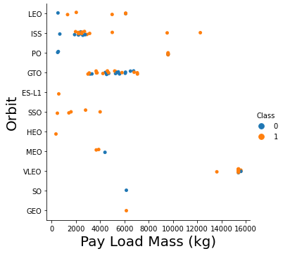
Payload vs. Orbit Type
Payload masses seem to be similar depending on the orbit.
ISS, GTO, and VLEO show the tightest grouping of payload per orbit.

Slide 23
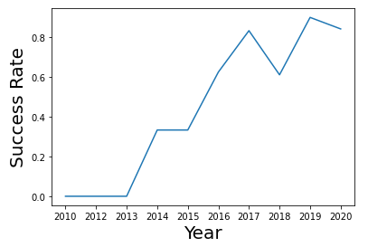
Launch Success Yearly Trend
We see that since 2013, the success rate of launches has significantly increased.
There was a sharp decrease and an equally sharp recovery in success rate between 2017 and 2019.

Slide 24
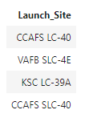
All Launch Site Names
These are the launch sites in the data.

Slide 25
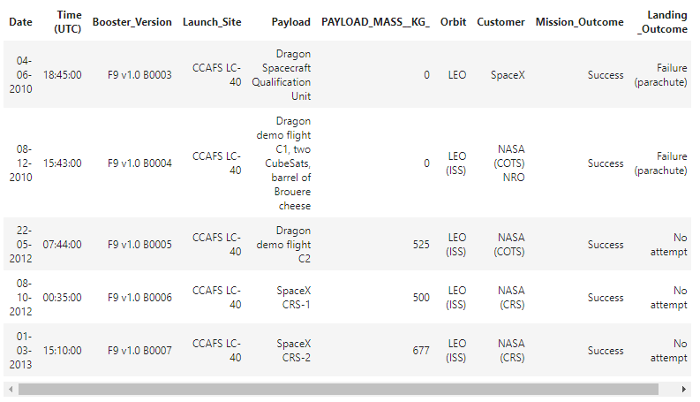
Launch Site Names Begin with 'CCA'
Here are 5 records where launch sites begin with “CCA.”

Slide 26
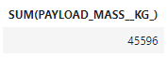
Total Payload Mass
The total payload carried by boosters from NASA is 45,596 kg.

Slide 27
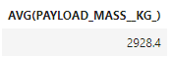
Average Payload Mass by F9 v1.1
The average payload mass carried by booster version F9 v1.1 is 2,928.4 kg.

Slide 28
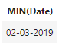
First Successful Ground Landing Date
The date of the first successful landing outcome on ground pad is:

Slide 29
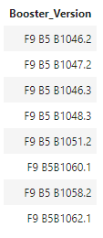
Successful Drone Ship Landing with Payload between 4000 and 6000
The names of boosters which have successfully landed on drone ship and had payload mass greater than 4000 but less than 6000 are:

Slide 30
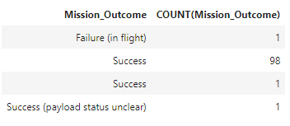
Total Number of Successful and Failure Mission Outcomes
The total number of successful and failure mission outcomes:

Slide 31
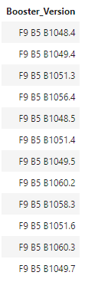
Boosters Carried Maximum Payload
The names of the booster which have carried the maximum payload mass are:

Slide 32
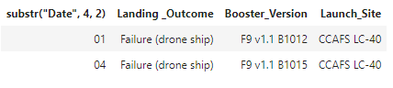
2015 Launch Records
The failed landing_outcomes in drone ship, their booster versions, and launch site names for in year 2015:

Slide 33
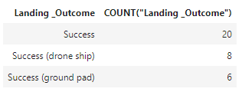
Rank Landing Outcomes Between 2010-06-04 and 2017-03-20
Ranking the count of landing outcomes (such as Failure (drone ship) or Success (ground pad)) between the date 2010-06-04 and 2017-03-20, in descending order:

Slide 34

Section 3

Slide 35
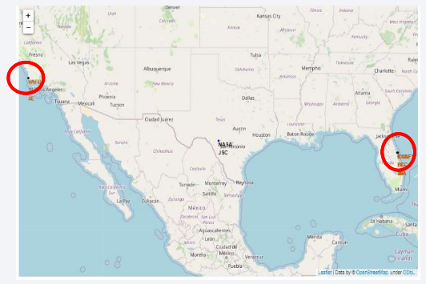
Launch Site Locations
All launch sites are close to the coastline.

Slide 36
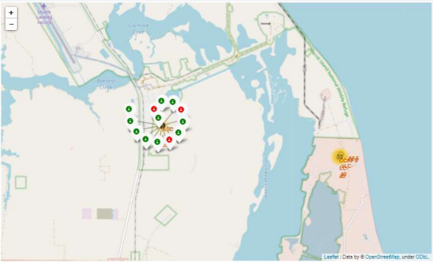
Success Rate of Rocket Launches
The successful launches are represented in green.
The failed launches are represented in red.

Slide 37
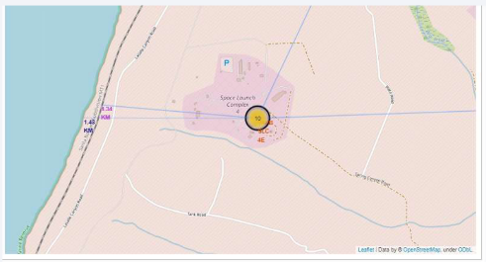
Surrounding Landmarks
It looks like the launch sites are close to the shoreline as well as highways and railroads. However, they are farther away from high density populations such as towns and cities.

Slide 38

Section 4

Slide 39
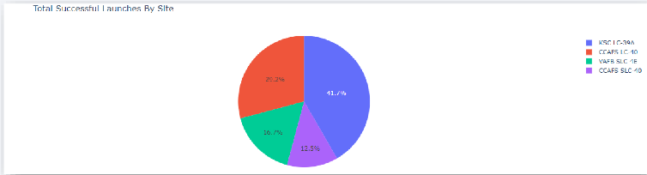
Successful Launches by Site
Here, we can see that the launch site KSC LC-39A has the largest proportion of successful launches.

Slide 40
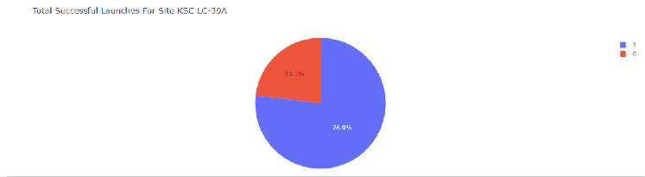
Total Successful Launches for Site KSC LC-39A
We can see that site KSC LC-39A has a success rate of 76.9%. This is the highest success rate of any launch site.

Slide 41
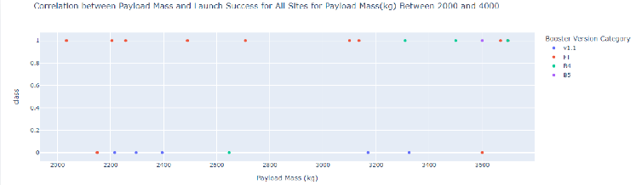
Payload Mass vs Launch Site Success Rate
There is no clear distinction between the payload mass and the success rate of each launch. There are scattered successes and failures between 2,000 and 4,000 kg.

Slide 42

Section 5

Slide 43
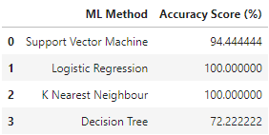
Classification Accuracy
We can see the Logistic regression and K Nearest Neighbor had the highest accuracy scores of 100%.
Please note that there were issues loading the data into IBM Visual Studio and I also encountered several errors with the lab. So, these results may be flawed.

Slide 44
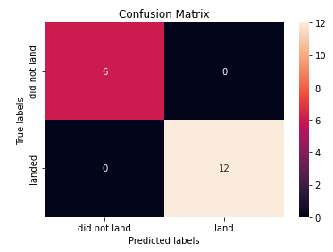
Confusion Matrix
Both logistic regression and knn had the same confusion matrix. We can see that the model accurately predicted the True values for “landed” and “did not land.”
Please note that there were issues loading the data into IBM Visual Studio and I also encountered several errors with the lab. So, these results may be flawed.

Slide 45
Conclusions
From all this information, we can see that the launch sites are mostly located near coastlines, highways and railroads, but farther away from population centers.
The site KSC LC-39A has the highest launch success rate out of all launch sites.
The success rate of launches significantly increased after 2013, with a drastic fall and an equal rebound from 2017 to 2019.
The best machine learning models were logistic regression and k nearest neighbors with an accuracy score of 100%.
Please note that there were issues loading the data into IBM Visual Studio and I also encountered several errors with the lab. So, these results may be flawed.

Slide 46


